Slide 1
Subsurface parameters & calibration

Slide 2
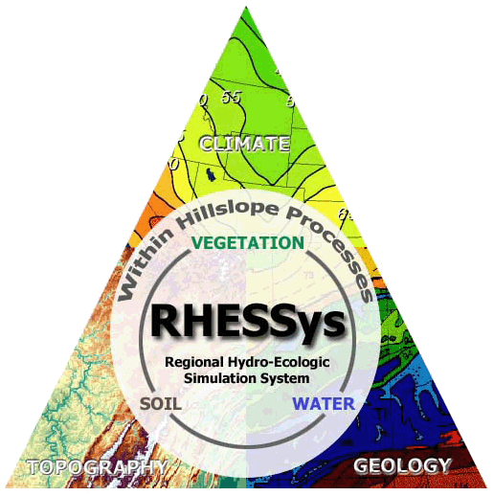
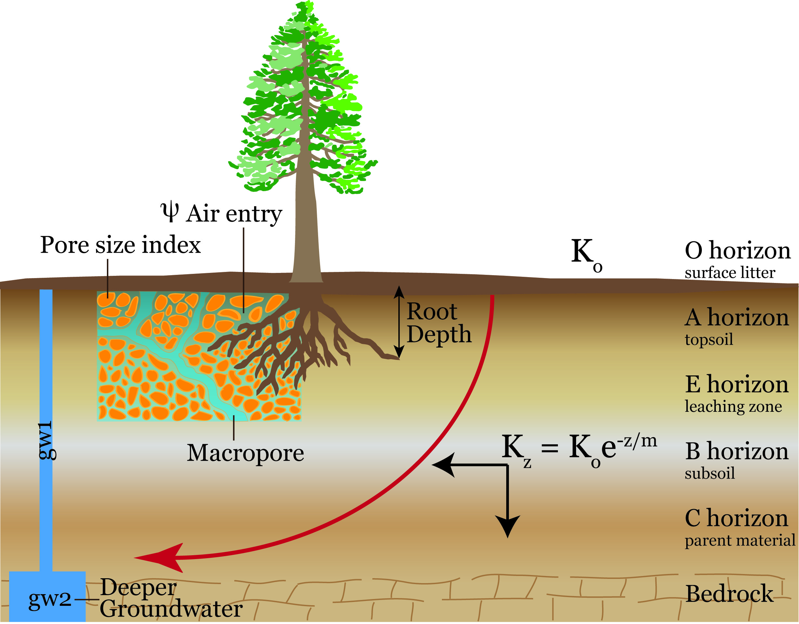
Calibrated soil drainage parameters

Slide 3
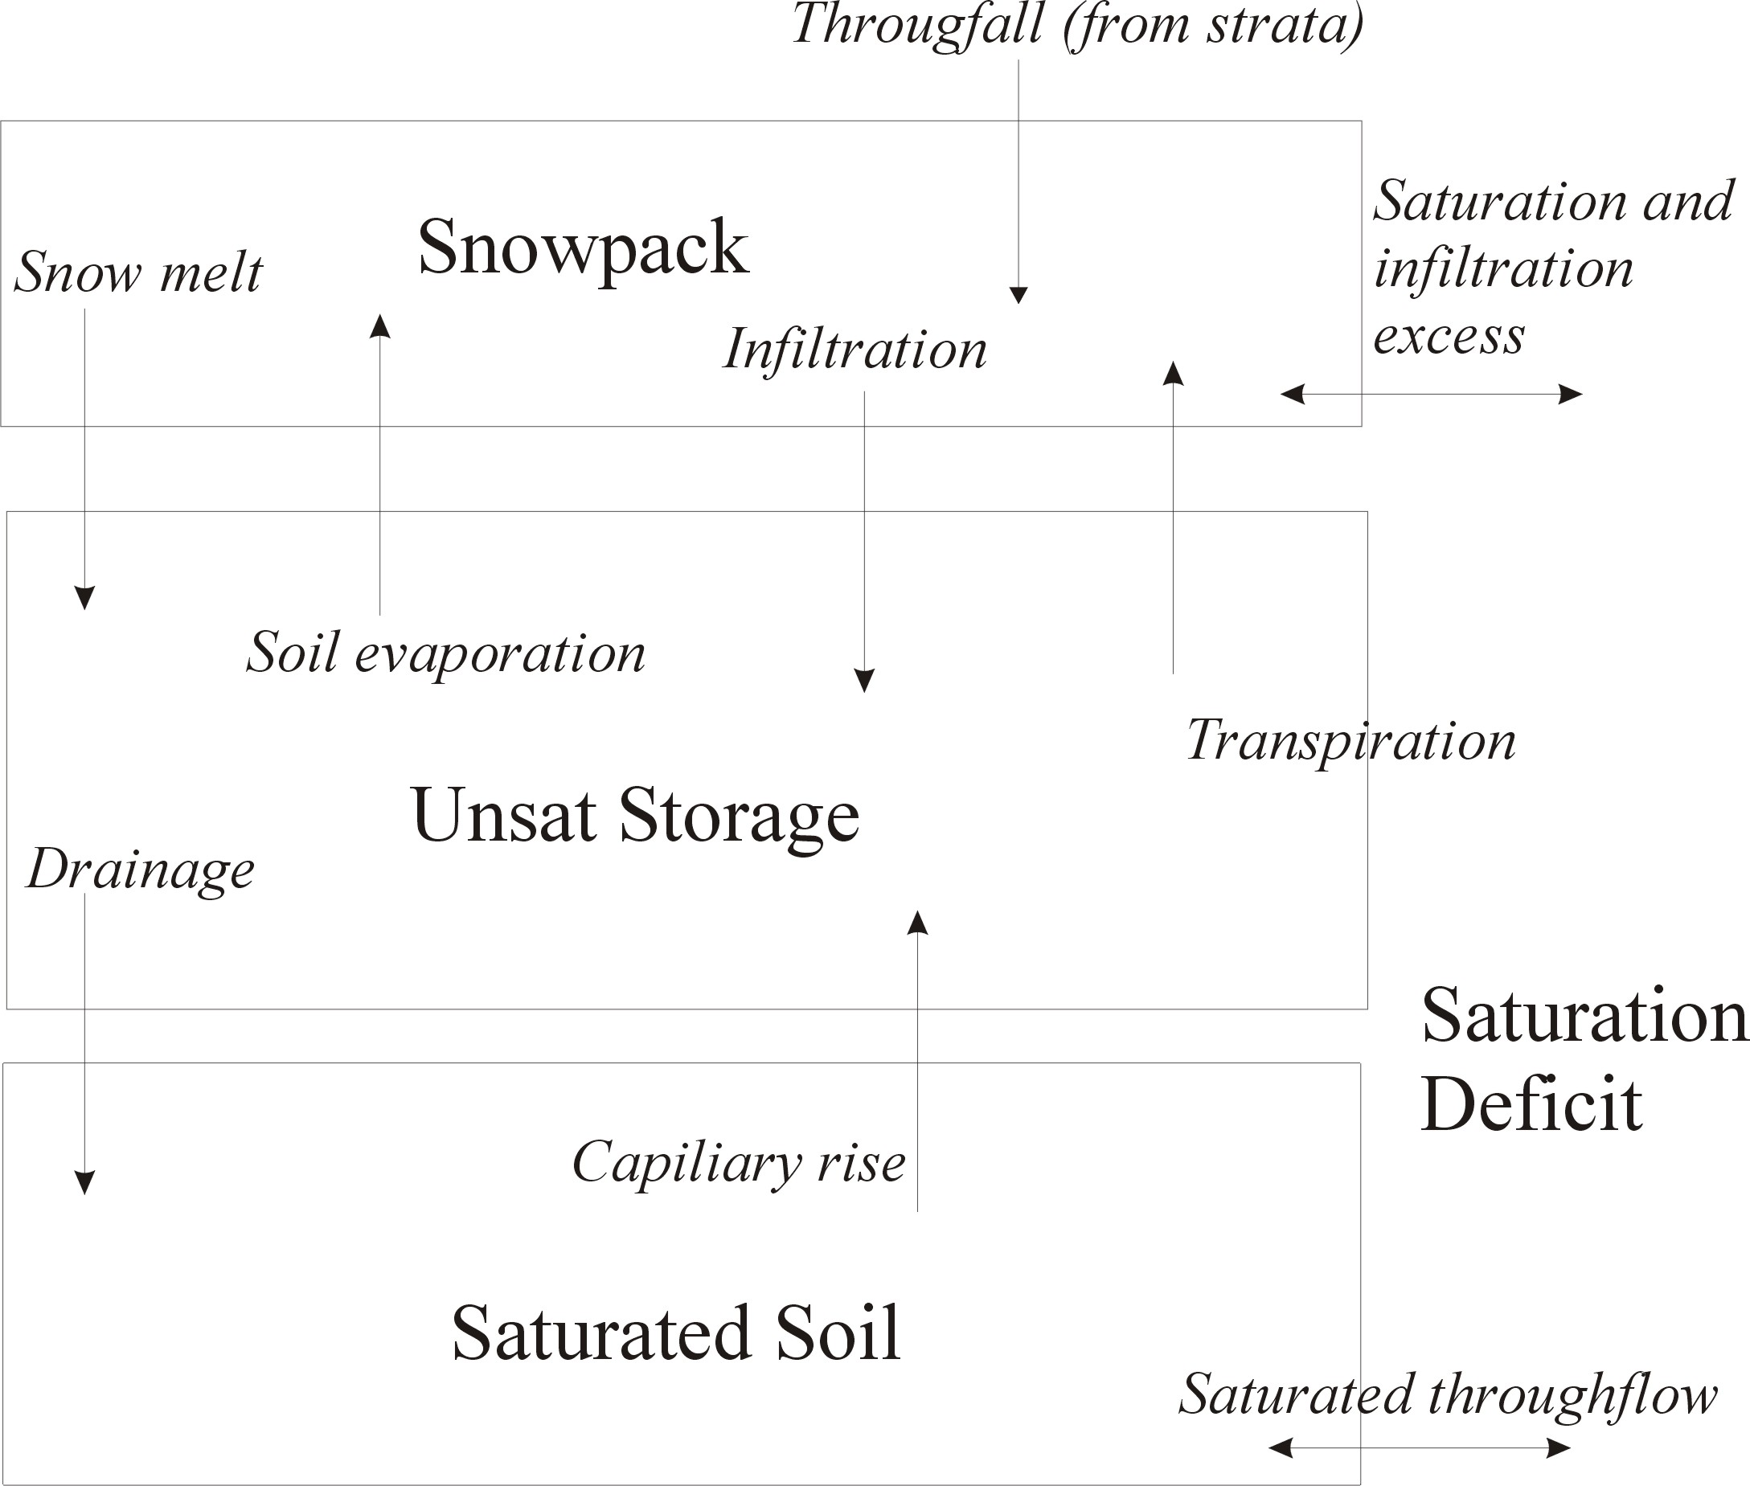
Vertical and lateral water fluxes
Notes:
They also model vertical and lateral water fluxes.
This is a simple 3 layer model which includes a surface detention store, an unsaturated store, and a saturated store.

Slide 4
Key subsurface parameters
Patch def file
Ksat_0: Saturated hydraulic conductivity at surface
m: Decay of saturated hydraulic conductivity with saturation deficit
pore_size_index: Soil pore size index
psi_air_entry: Soil air entry pressure
sat_to_gw_coeff: the amount of water moving from the saturated store to the groundwater store; bypasses roots
soil_depth: Maximum soil depth
Hill def file
Qw_loss_coeff: Percent of groundwater store lost to stream

Slide 5
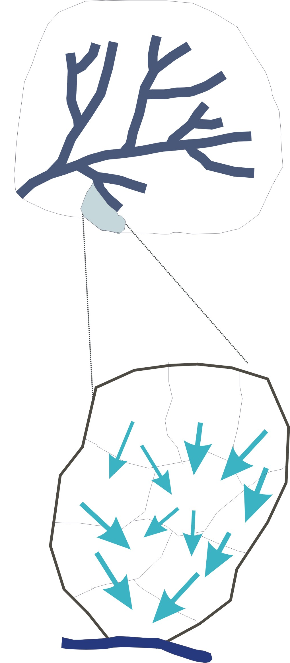
RHESSys Routing
Basin
Stream Flow Routing
Hillslope
Patch Routing
(within hillslope routing of overland and saturated subsurface throughflow)
Notes:
So once water moves thru all those processes and thru the landscape, it then reaches the stream and exits from the watershed - we don’t do much in the stream at the moment in RHESSys but its on the table for future development

Slide 6
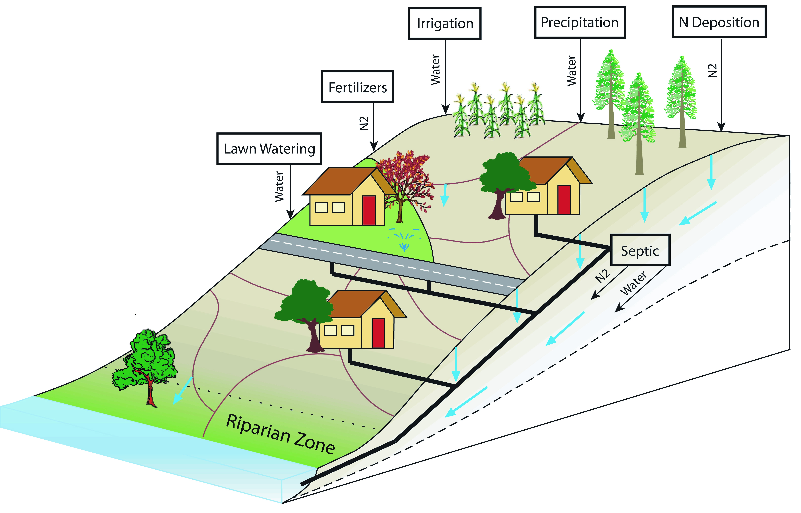
Modeling the Urban landscape

Slide 7
Calibration
Calibration is an iterative process of comparing the model to the real system, making adjustments to the model as necessary, then repeating.
Where do parameter values come from?
Literature
Measurement
Expert decision-making
Optimization to observed data

Slide 8
Steps for optimization to observed data
Establish plausible ranges for parameters of interest
Decide on how many iterations (n) you want to run model.
Generate n parameter sets.
Run model for each parameter set
Compare model outputs to observed variables.
Qualitative and Quantitative

Slide 9
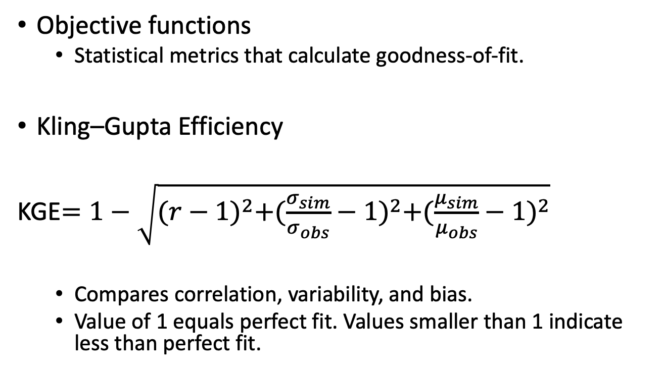
Quantitative comparison of model output and observed variables
Objective functions
Statistical metrics that calculate goodness-of-fit.
Kling–Gupta Efficiency
KGE$=1−\sqrt{{(r−1)}^{2}+{(\frac{σ_{sim}}{σ_{obs}}−1)}^{2}+{(\frac{μ_{sim}}{μ_{obs}}−1)}^{2}}$
Compares correlation, variability, and bias.
Value of 1 equals perfect fit. Values smaller than 1 indicate less than perfect fit.

